Slide 1

Market Analysis of locations for The Dancing Dog
Andrea brice,
Cherry picking enterprises August, 2014

Slide 2
Purpose and Sources
“Location, location, location” – the famous words of making or breaking a successful enterprise. This presentation includes the analysis, maps, and other information which were gathered for review by the owners of The Dancing Dog in Seattle, Washington.
The 32 addresses analyzed here were profiled because they fit specific demographic characteristics identified by the owners as their primary customer. The data was sourced from the U.S. Census data gathered from the Commercial MLS site for the locations of interest. This was then cross-referenced with the ESRI Tapestry Segments, Walk Score, and the Liveability scores from AreaVibes.

Slide 3
Target Customer Profile
The 2000 and 2010 Census demographic data we are using to target The Dancing Dog's demographic is published by a company called Esri. They have classified the 2000 and 2010 demographic data and updates of the US residential neighborhoods into "67 unique segments" based upon demographic and socioeconomic characteristics. The Dancing Dog is using the Esri Tapestry LifeMode Summary Groups to identify the Target Areas best suited for this venture by identifying the people who will find The Dancing Dog most interesting. They will be those Segment Groups which belong to the Urbanization Summary Group U1 and the LifeModeSummary Group L2 or L4. These groups are characterized by people who “travel extensively, especially abroad, and to seek out new food or drink experiences.” They want to learn new things to "keep life fresh and variable." They are professionals who live a "sophisticated lifestyle," avid readers who also read a variety of newspapers and magazines, who love listening to fresh music, and seldom watch TV. They buy natural, green, and environmentally friendly products and eat organic foods. They are well educated consumers who research their products. They are tech savvy and attached to their PCs and Smartphones.
They live in residential areas with single-family homes in suburban neighborhoods with easy access to the city. They prefer city life, looking for the best that city life has to offer in a small city like Seattle. They look for breaks in constant connectivity, actually engaging in activities such as painting, drawing, landscaping, and remodeling. They primarily belong to Segment groups identified as the "Urban Chic," "Trend Setters," "Laptops and Lattes” / "Emerald City," or the "Metro Renters." (esri.com/tapestry).
The Dancing Dog is targeting these sectors with their embrace of the "foodie" culture, adventurous eating, and epicurean expectations in their drink. These well-educated consumers expect an ambience to match. This, too, will set The Dancing Dog apart. It is neither formal, nor dark and dingy.
Market Characteristic | Preference
Walkability Score | 80 or greater
Liveability Score | 85 or greater
% of Population w/ Income > 75K | 30%
Median Household income | $80,000+
Per capita income | $35,000+
Median Age | 35-45
Primary diner trait | Embrace the "foodie" culture, enjoy cooking adventurous meals using local and organic foods.
Occupations | Professional, management, and sales positions in the scientific, technical services, educational services and health care industry sectors.

Slide 4

The Captured Data for 32 Addresses
Includes data from the U.S. Census

Slide 5
The Captured Data for 32 Addresses
The Walkability Indexes
The Liveability Indexes
The Top 2 or 3 Esri Tapestry Segments

Slide 6
DASHBOARDS
A VARIETY OF METRICS REPORTED

Slide 7
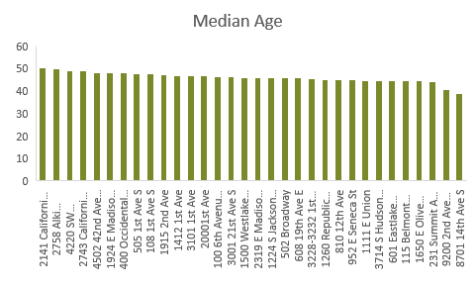
Basic Demographics

Slide 8
and Relative Ranking information

Slide 9
Median Age: Rank = 1 (lower) is older
Entertainment Spending: Rank = 1 (lower) is more

Slide 10
Map Views
Leveraging the power of excel’s 3d map views and joining it with the exceptional market data found from the esri analysis

Slide 11
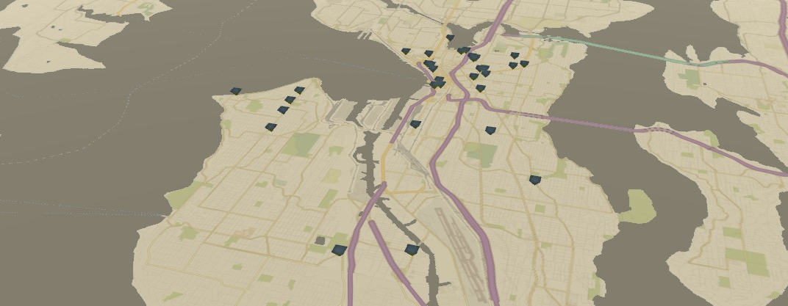
The mapped location possibilities for The Dancing Dog

Slide 12
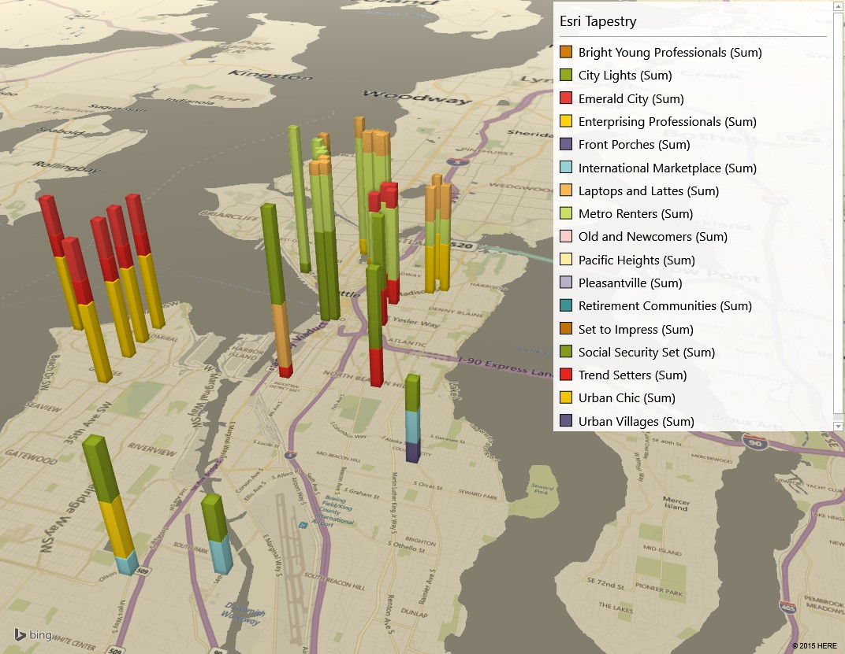
3D map views which show the distribution of Esri Tapestry Segment information per location

Slide 13
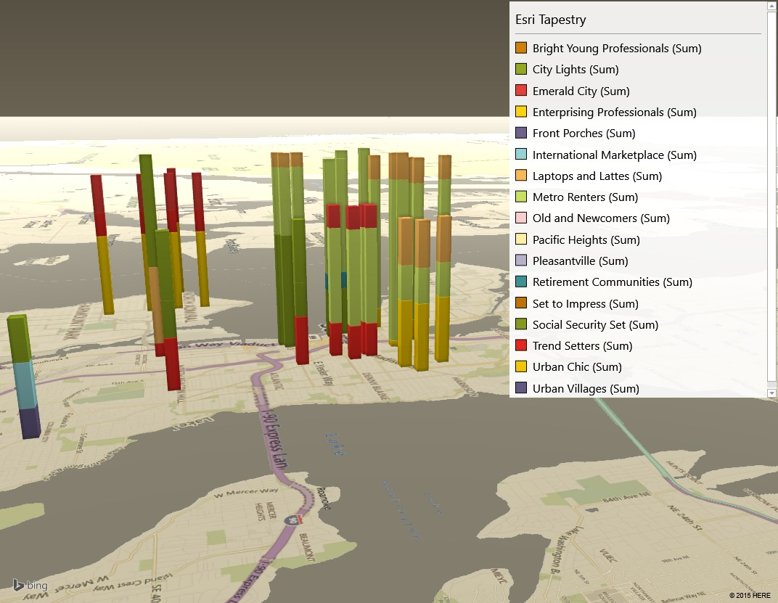
Through which the owners can rotate, zoom, and interact with.

Slide 14
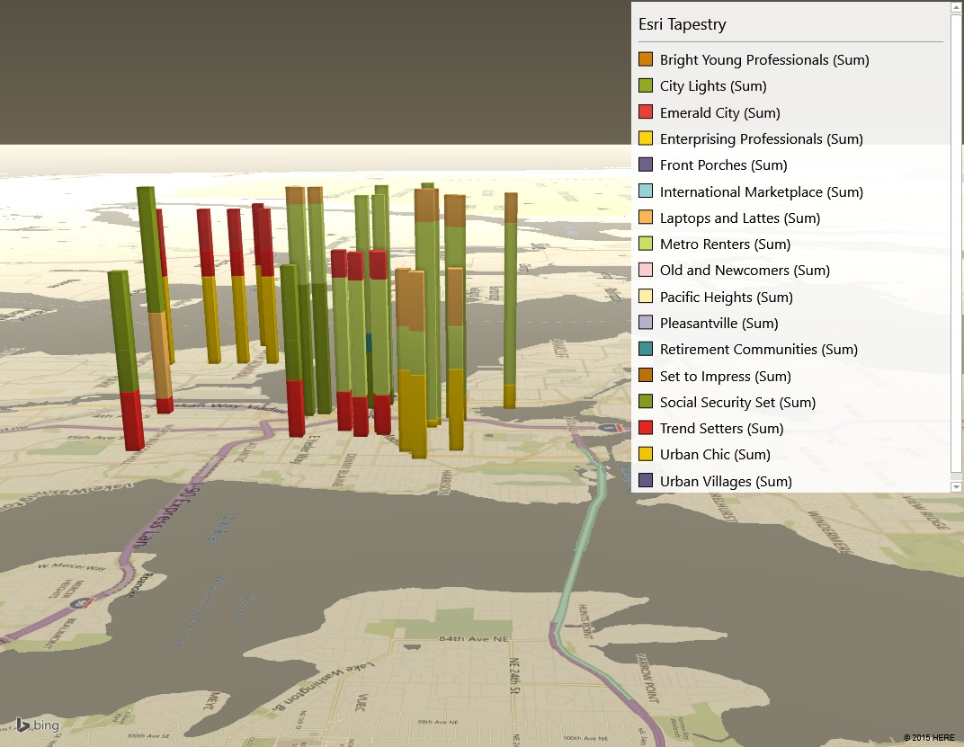

Slide 15
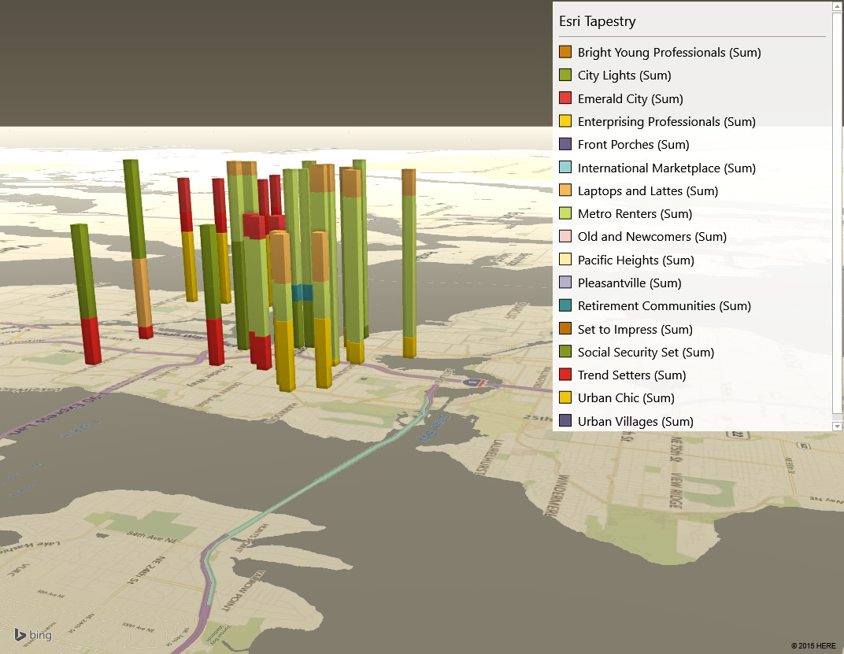

Slide 16
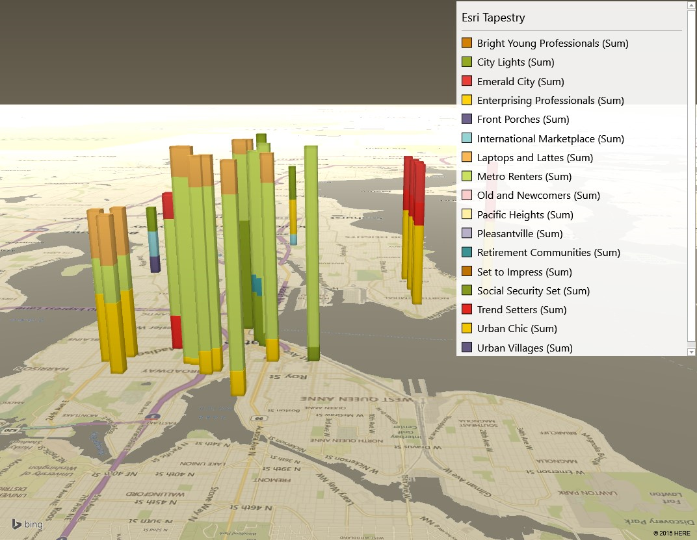

Slide 17
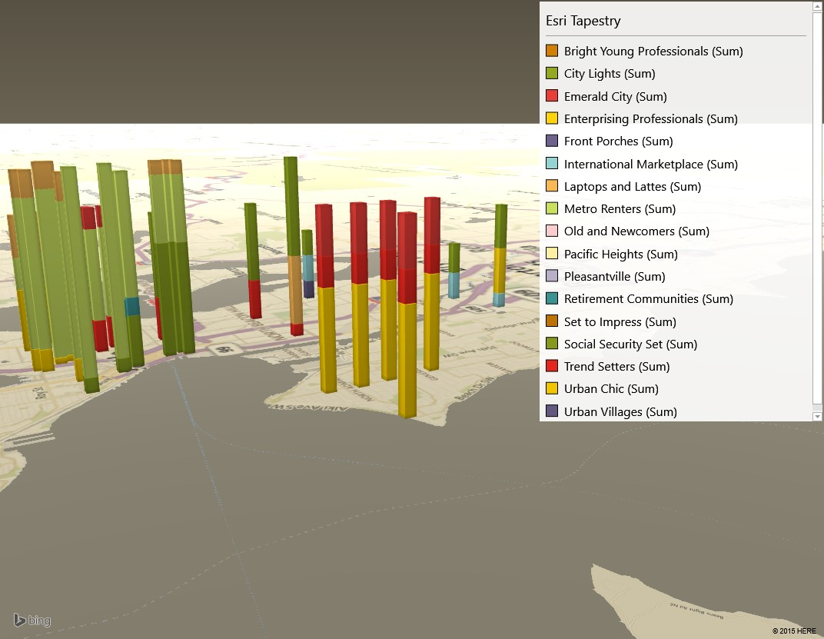

Slide 18
The Esri distribution reduces to this 2D chart

Slide 19
Summary of Lifestyle Scores

Slide 20
This concludes the presentation of The Dancing Dog Real Estate Analysis
Andrea Brice

